Slide 1

The Regenstrief G3 System: A Next Generation CPOE Built on an Open-Source Framework
Jon D. Duke, Burke Mamlin, Doug Martin
AMIA 2011
Notes:
The Regenstrief Institute, a pioneer in physician order entry and clinical decision support systems, is currently in the midst of deploying a new platform built on open-source technologies. The centerpiece of this effort is G3, a CPOE designed to support advanced research in clinical decision support, usability, physician workflow, and patient safety. We will be demonstrating this new system, with a focus on its interface design, CDS architecture, natural language processing capabilities, and provider communications. We will also be discussing our user-centered design process, opportunities for collaboration, and future development plans.

Slide 2
Conflicts of Interest
Dr. Duke has no conflicts of interest to report
Dr. Mamlin has no conflicts of interest to report
Dr. Martin has no conflicts of interest to report
Notes:
Intro - Jon
Brief homage to Gopher classic, need for update
Functional, Usabilty, and User Experience Goals
Refresher on the Framework - Doug
G3 Workflow - Burke
Possible ideas: ETs, ability to create lots of different workflows for diff user types, keyboard shortcuts
Ordering - Burke
Possible ideas: Medication ordering (incl smart forms, templates, use of RxNorm, Express features, drag and drop), cart metaphor, order sets
CDS - Jon
NLP stuff
Contextual Alerts
InfoPanel Stuff
?PROSPECTy stuff
Search - Doug
Lucene / SOLR
UI / demo
Conclusion / ? Open-source directions

Slide 3


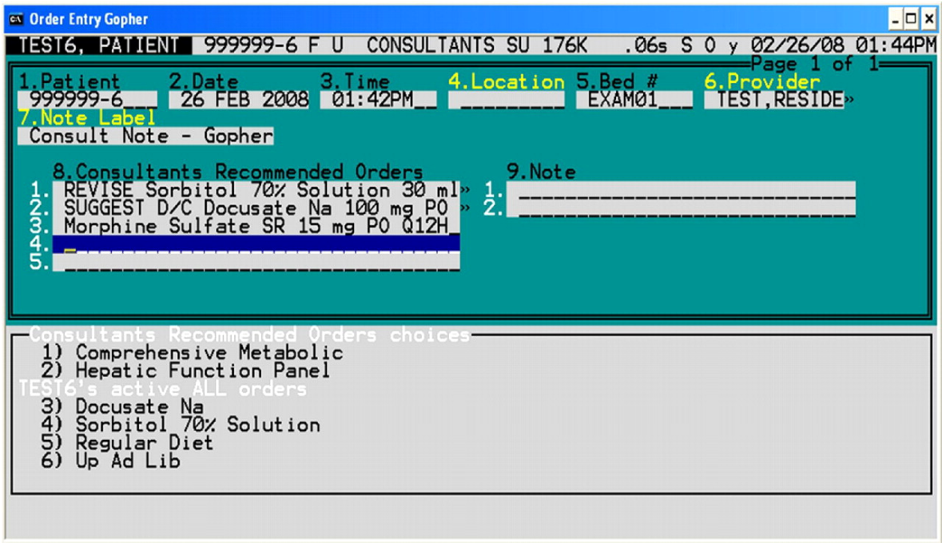
Introduction

Slide 4
Gopher
Gopher grew from a small clinic to over 1000 workstations, inpatient and outpatient
25+ years of iterations lead to robust functionality and efficiency
Served as the research platform for many of the seminal studies in medical informatics

Slide 5
1984
2010

Slide 6
In 2009 Regenstrief began rebuilding its core clinical information system platform
In 2010, we began work on a new outpatient CPOE system to replace the venerable Gopher
In designing this new system, we sought to leverage our experience with Gopher as well as ongoing research in CPOE and human factors

Slide 7
A Tour of G3
Overview of the Regenstrief Framework
Functional and Usability Goals for G3
G3 Design and Demonstrations
Workflow
Order Entry
CDS
Chart Search
Next steps in development and collaboration

Slide 8
CareWeb Framework
Web-based
Built on open source technologies
Modular design
Emphasis on component re-use
Extensible architecture
Ease of development
Minimal configuration
Support our research mission!

Slide 9
Key Technologies
Spring Framework
Spring Security
ZK Framework
JQuery
Oracle Help for Java
Apache ActiveMQ Server
Apache Web Server
Apache Tomcat
Oracle / PostgreSQL

Slide 10
Architecture
User
Interface
Flowsheet
Order
Entry
User Preferences
Web
Resources
SMArt
Plug-in
Plug-in
Widgets
Electronic
Signature
Patient
Selection
User
Authentication
Plug-in
Services
Layout
Manager
Layout
Designer
Framework
Services
Internal
Services
Electronic
Signature
Patient
Context
User
Context
Plug-in
Services
Context
Management
Event
Management
Component
Registration
Help
Subsystem
Theme
Support
Framework
Services
External
Services
Data
Access
Security
Services
Messaging
Services
Web
Services
Core
Services

Slide 11
Plug-in Inventory
Results display
Recent results
Flowsheet
Clinical abstract
Clinical documents
Encounter display
Order summary
Chart search
Data capture
Results entry
Order entry
Note Writing
Document uploader
Electronic signature
Problem list management
User tools
User preferences
User feedback
Notifications
Administrative
User management
Remote troubleshooting
Property management
Administrative reports
Concept mapping
Research
Medication reconciliation
Med profile visualization
SMArt plug-ins
Notes:
Switch to demo – show plugins, help content, about box, design mode.

Slide 12

Designing G3

Slide 13
G3 Requirements and Goals
Functional Requirements
Order Entry
Note Writing
Medication / Problem / Allergy Management
Clinical Decision Support
SureScripts / Meaningful Use Compliance
Integrate with Research Platform
Support Existing Gopher Content

Slide 14
G3 Requirements and Goals
Usability and User Experience Goals
Safe
Efficient
Support novice and expert users
Minimal training required
Intuitive interface leveraging existing metaphors
Keyboard and mouse friendly
Avoid Information Overload

Slide 15
Workflow in G3
Goal was to support multiple workflows for each user type based on
Role (e.g., MD, RN, Dietitian)
Training Level (e.g., Attending, Resident, Student)
Specific Permissions
“Wizard”-like guide generated for each type of transaction
Users can navigate in any order

Slide 16
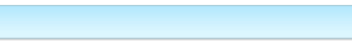
Workflow in G3
Notes:
In G3,

Slide 17
Order Entry
E-commerce Cart metaphor
Add, update, and delete items from cart
Single search bar for all orderables
Multi-word autocompleter
Common matches shown at top
Icons to demonstrate formulary status
Batch renewal and d/c of medications
Drag and drop ordering and information

Slide 18
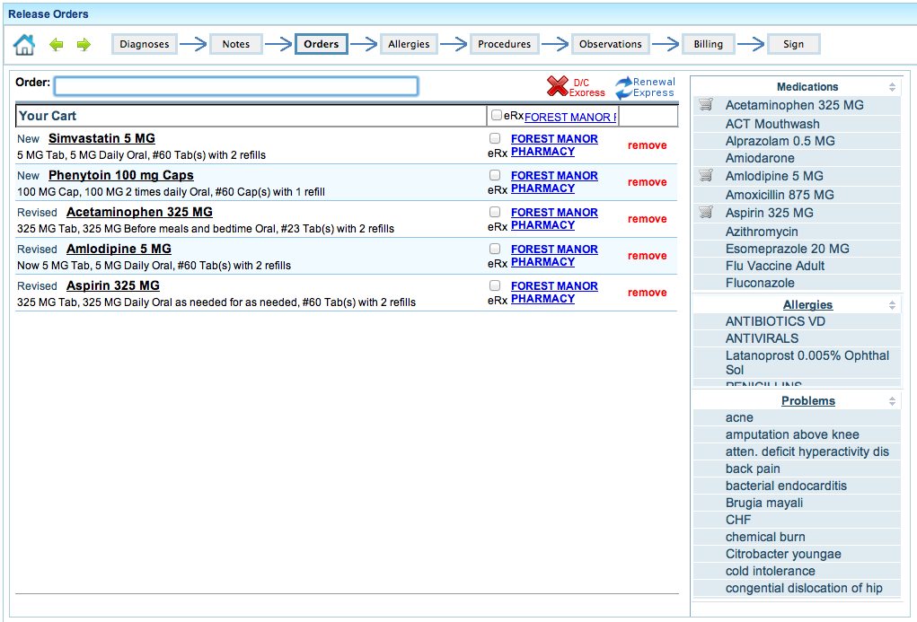
Order Entry
Notes:
We use an e-commerce type cart for placing orders.
Orders can be added, updated, or deleted from the cart.
Medications can be marked for e-prescribing

Slide 19
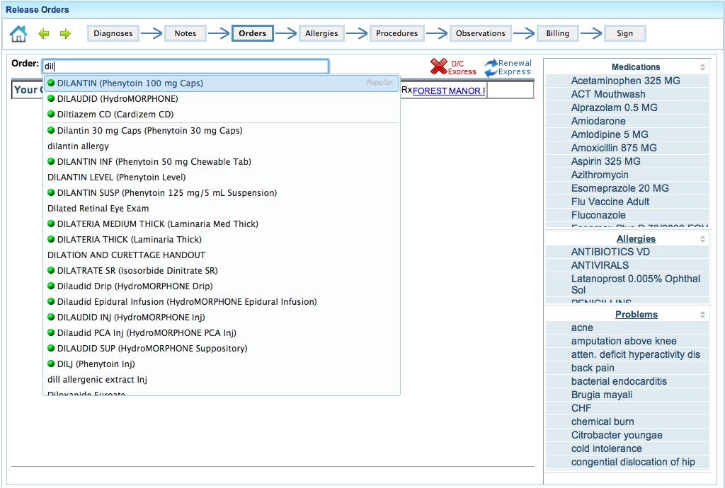
Order Entry
Notes:
Autocompleter shows popular orders first.
Formulary medications have a “green light”
There’s are convenient batch operations for d/c’ing or renewing orders
Orders can be dragged into the cart

Slide 20
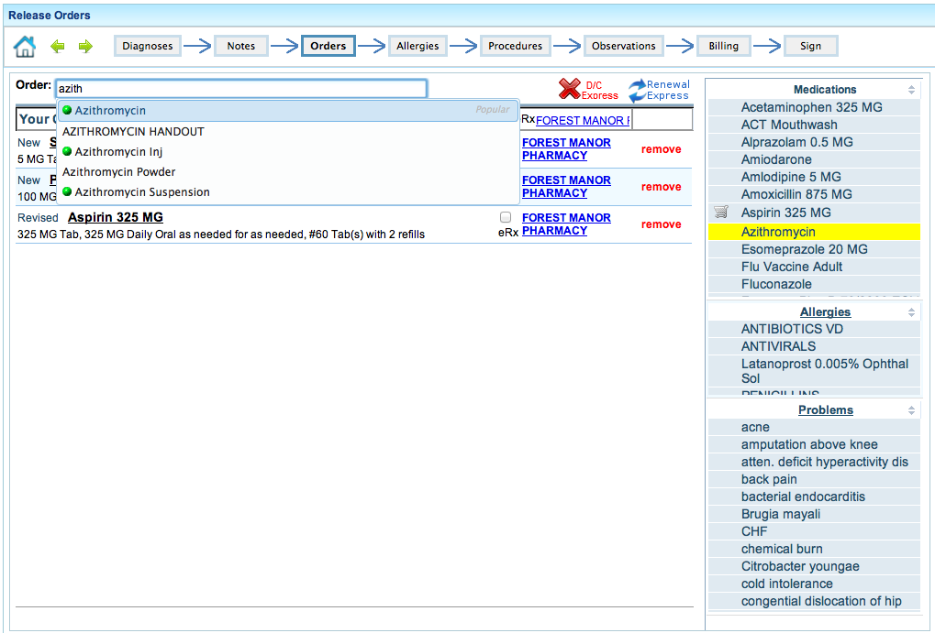
Order Entry
Notes:
Active orders are highlighted
Orders in the cart have a shopping cart icon

Slide 21
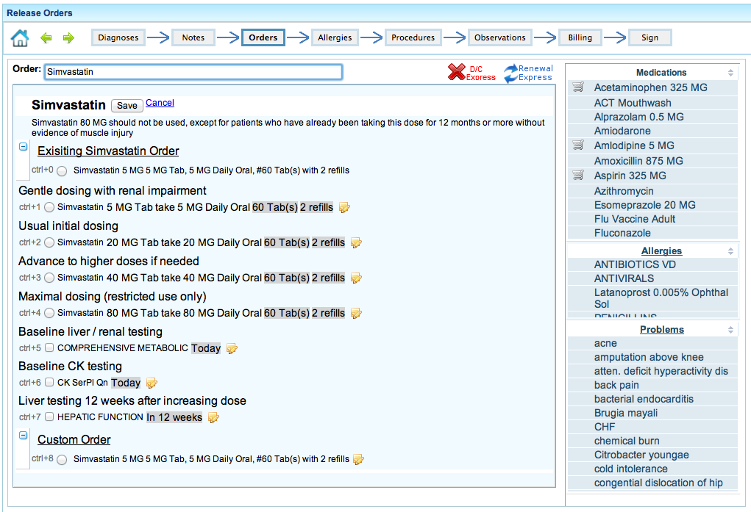
Medication Ordering
Notes:
Order sets simplify and speed up ordering by providing pre-filled order templates
Order sets might suggest relevant tests, patient handouts, etc. when ordering a medication
We’ve built a basic order set authoring tool into the application

Slide 22
Medication Ordering
Order sets simplify & speed up ordering
Provide guidance (CDS)
Can suggest corollary orders (tests, handouts)
Basic authoring tool built-in
Notes:
Order sets simplify and speed up ordering by providing pre-filled order templates
Order sets might suggest relevant tests, patient handouts, etc. when ordering a medication
We’ve built a basic order set authoring tool into the application

Slide 23
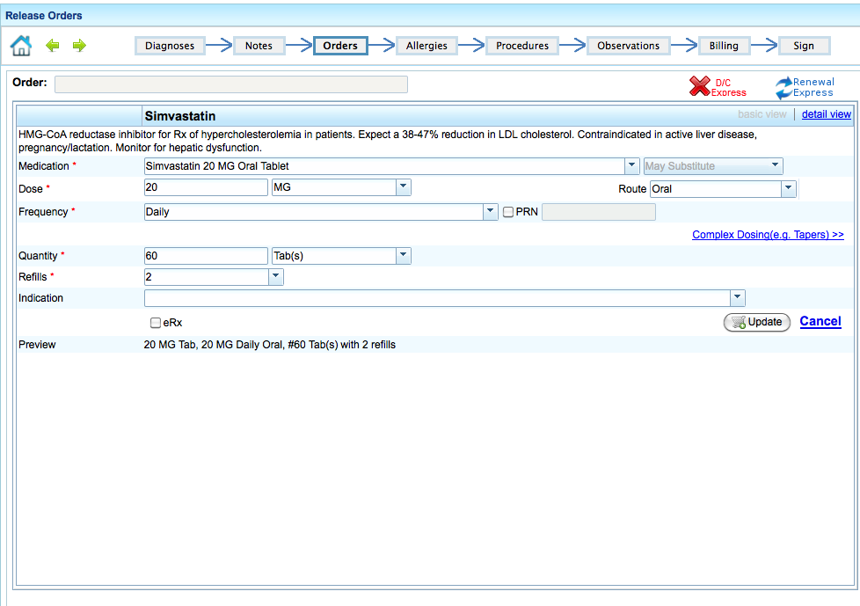
Medication Ordering
Notes:
When order sets are not available or you want to customize an order template, there’s an ordering form for collecting the order detail
We use RxNorm and RxTerm to drive choices for medication order details

Slide 24
Medication Ordering
Without an order set or when customizing an order, we show a basic order form
Varies by type of order
RxNorm plus local dictionary used to drive prescribing
Notes:
When order sets are not available or you want to customize an order template, there’s an ordering form for collecting the order detail
We use RxNorm and RxTerm to drive choices for medication order details

Slide 25
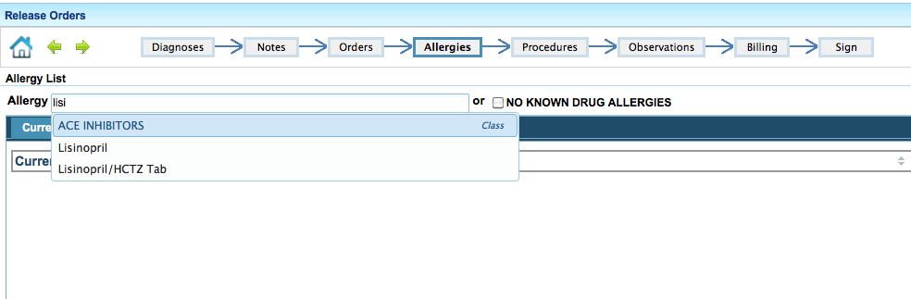
Allergy Entry

Slide 26
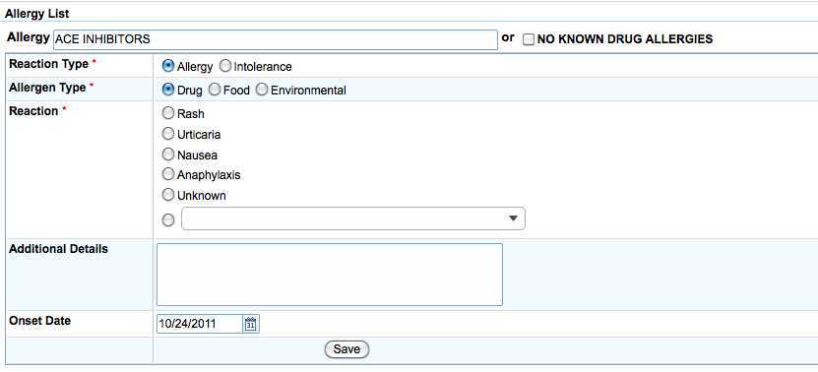
Allergy Entry

Slide 27
Clinical Decision Support
Contextual Alerting
Relevance Adjustment Module
Delivery mechanisms (e.g. interruptive, corner notifier, infopanel, dropdown, etc)
Non-alert support
Medication info on demand (pt specific and general)
Problem based concept lookup (UpToDate)
{Clinical Advisors for ordering?}
Article Linking / Reference Sharing

Slide 28
Clinical Decision Support
Dynamic Alert Display
InfoPanel
Real-Time NLP of Notes

Slide 29
Dynamic Alerts
Embedded mechanics to dynamically change alert display based on context
Presentation of alert can vary based on
Patient Context
Physician Context
Institutional Context

Slide 30
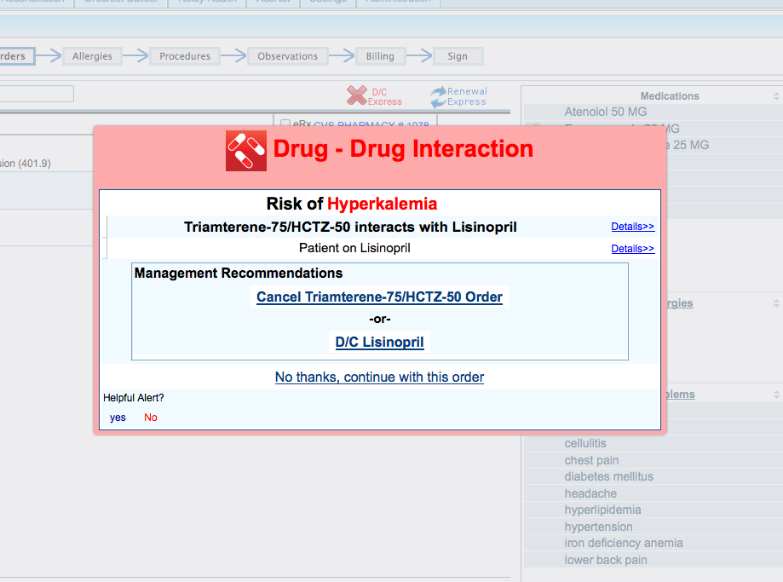

Slide 31
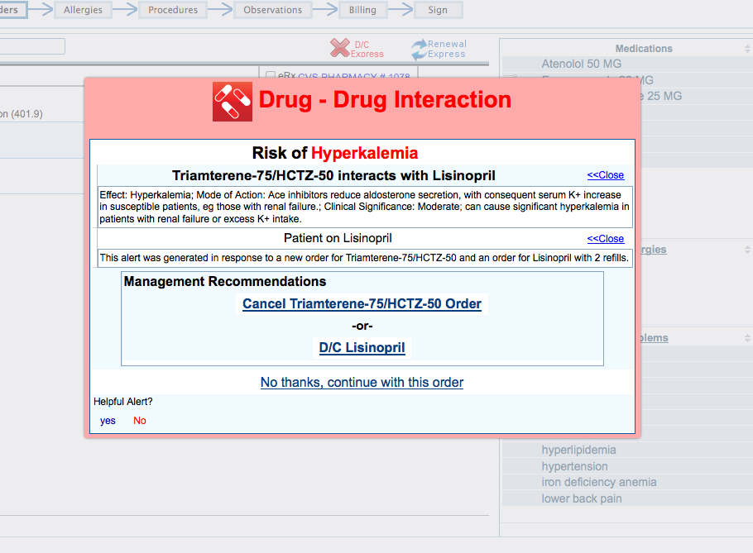

Slide 32
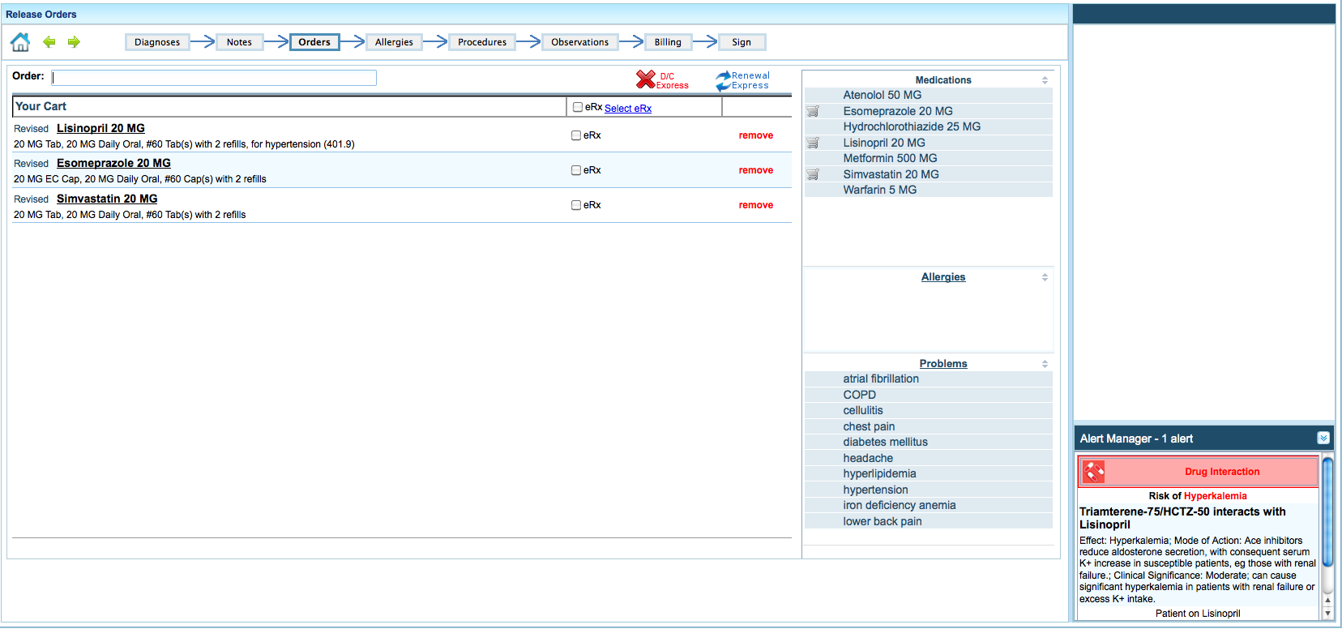

Slide 33
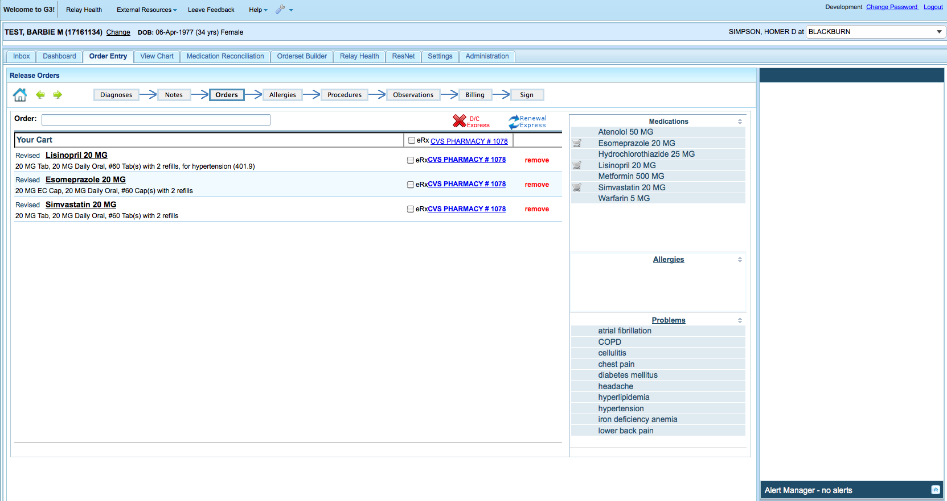
Alerting Zones

Slide 34
Azithromycin Order
Original Alert
Final Alert
AZITHROMYICN Interacts with WARFARIN
Risk of Bleeding
Severity: Moderate
Relevance: 5 (Average)
DDI
Alert Service
AZITHROMYCIN Interacts with WARFARIN
Risk of Bleeding
INR 3.4*, Hct 39.4
Relevance: 7 (High)
Relevance Adjustment Module
Data
Repository
Related Concepts
INR, HCT, PLT
Bleeding Has Relevant Labs:
INR, HCT, PLT
Patient has lab values:
INR 3.4*, Hct 39.4, Plt 212

Slide 35
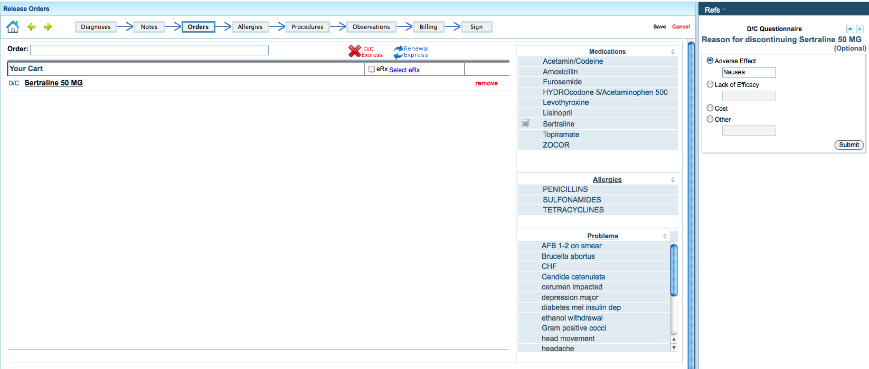
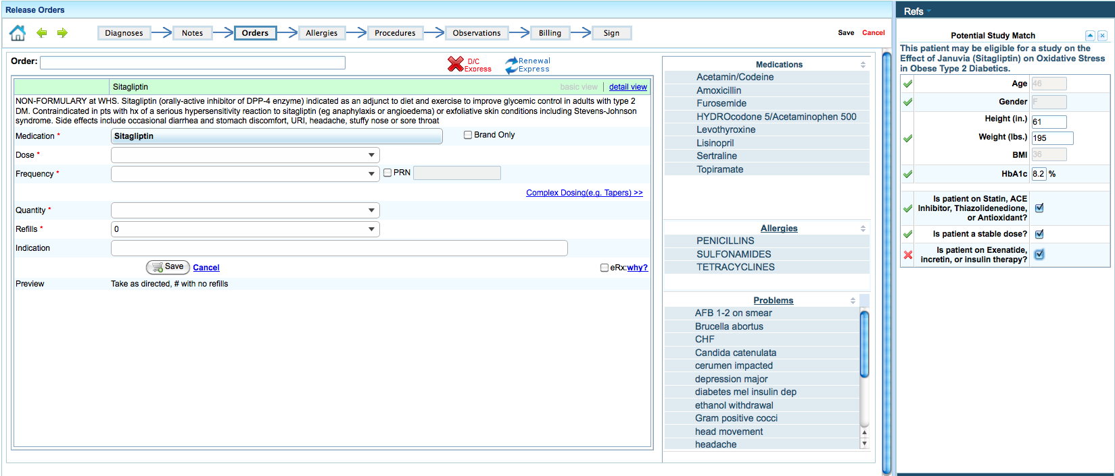
InfoPanel
An application-wide information stream
Designed for
informational messages
clinical advisors / calculators
“Twitter”-like team communications
Other apps

Slide 36
Real-Time NLP
Clinical notes are sent in real-time to an NLP pipeline as they are being entered
Text is simply “published” to the pipeline without awaiting a response, avoiding latency
One or more NLP services may be run (e.g.,for CDS, quality metrics, billing, recruitment, etc)
Consumer application of the NLP output may or may not be user-facing

Slide 37
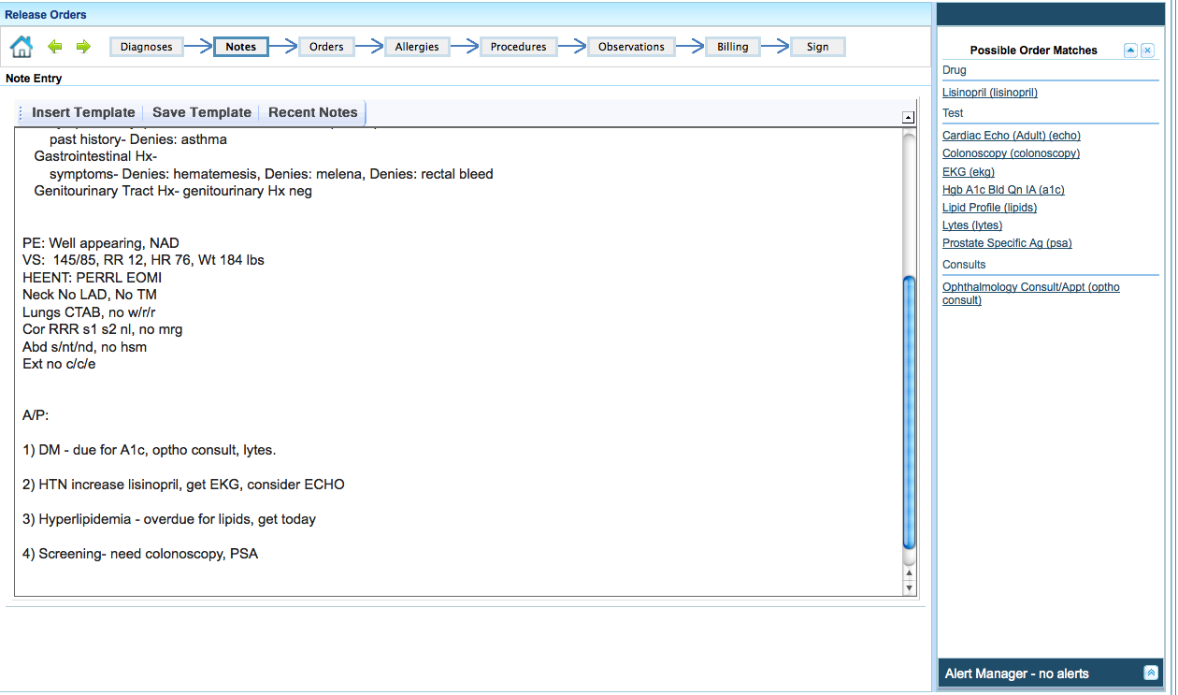
Real Time NLP

Slide 38
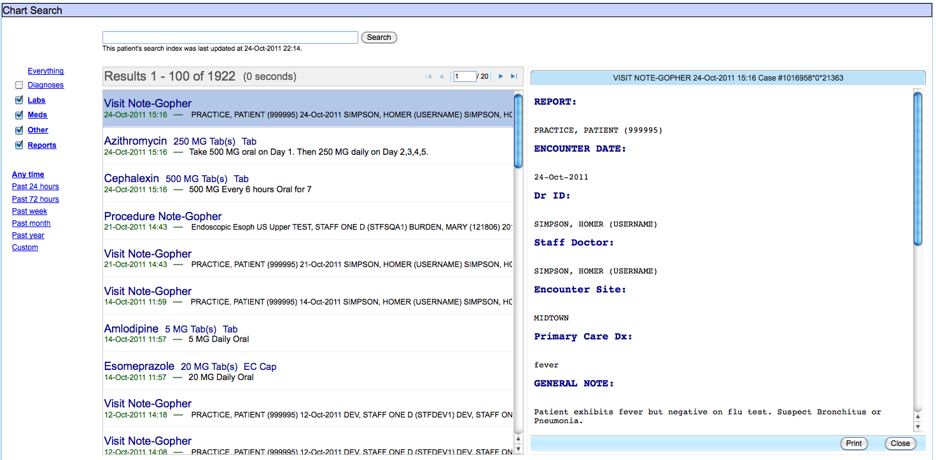
Chart Search

Slide 39
Chart Search
Google-like search capability
Blazingly fast look ups
Solr / Lucene text indexing / search engine
Highly extensible
Support for word stemming, equivalency, grouping

Slide 40
Chart Search
UI overview
Pluggable renderers - brief and detailed views
Filters
Patient preference considerations

Slide 41
Screencast / Live Demo
Demonstrate a few key areas:
Workflow
Ordering
CDS / InfoPanel / Note NLP
Search
Notes:
Search: http://172.31.1.195:8080/TestHarness-2.0.x/index.zul
Order Entry: https://172.30.204.39/CareWebAMIA/
http://172.31.1.10:8080/CareWebWishard/careWeb.zul
Order Entry 3.6: https://app-devel.regenstrief.org/CareWebWishard-3.6.x

Slide 42
G3 and Open Source
Regenstrief is committed to the development open source software and plan to follow this path with G3
We are eager for collaboration to sustain and expand G3’s potential in research and clinical care

Slide 43
Next Steps for G3
In production pilots now, moving from primary care to specialties
Enhancing UI
Building content
Expanding CDS and research capabilities
Inpatient development is now underway

Slide 44
Thanks! Questions? jduke@regenstrief.org dmartin@regenstrief.org

